Slide 1
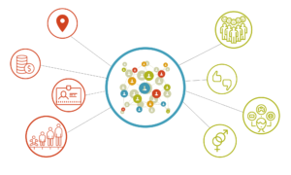
Capstone Project
Online Retail Customer Segmentation
Team Members
Ankit Patel
Sushmita Chaudhary

Slide 2
CONTENTS
Introduction
Problem Statement
Methodology
Loading the data
Hypothesis Testing
Exploratory Data Analysis
Treating missing values and outliers
Feature engineering
Data Modeling
Conclusion

Slide 3
INTRODUCTION
Customer segmentation is the process by which you divide your customers up based on common characteristics – such as demographics or behaviours, so you can market to those customers more effectively.
These customer segmentation groups can also be used to begin discussions of building a marketing persona. This is because customer segmentation is typically used to inform a brand’s messaging, positioning and to improve how a business sells – so marketing personas need to be closely aligned to those customer segments in order to be effective.
The marketing “persona” is by definition a personification of a customer segment, and it is not uncommon for businesses to create several personas to match their different customer segments.
But for that to happen, a business needs a robust set of customer segments off of which to base it. Which leads us to the next section, distinguishing the difference between customer segmentation and market segmentation, so that your segmentation is as accurate as possible.

Slide 4
PROBLEM STATEMENT
In this project, your task is to identify major customer segments on a transnational data set which contains all the transactions occurring between 01/12/2010 and 09/12/2011 for a UK-based and registered non-store online retail. The company mainly sells unique all-occasion gifts. Many customers of the company are wholesalers.

Slide 5
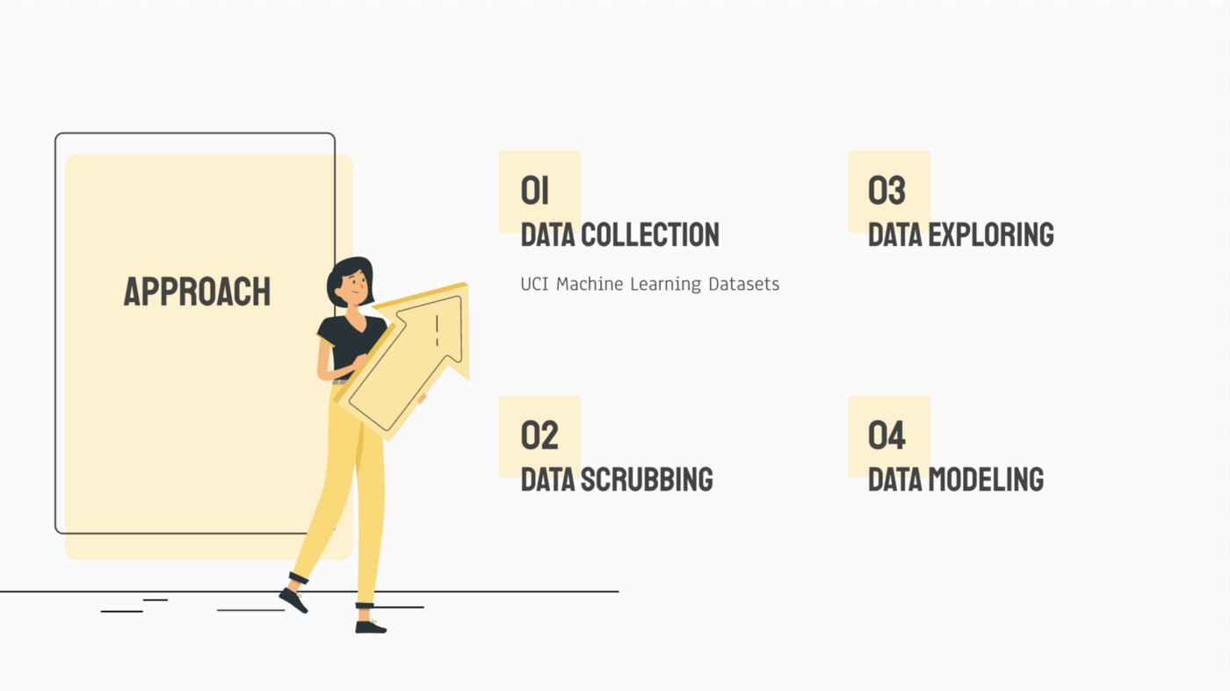
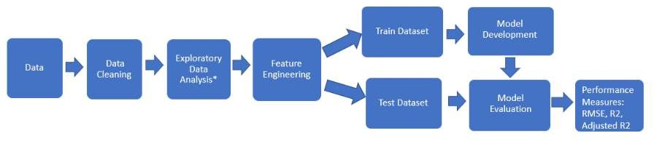
METHODOLOGY

Slide 6
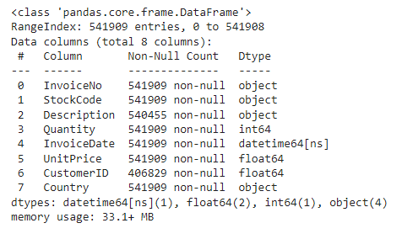
LOADING THE DATA AND DATA CLEANING
After loading the data, we can observe that the data frame contains
541908 rows with 8 variables. And we are trying to have an insight on missing values.

Slide 7
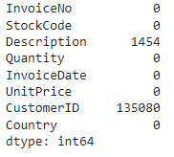
SPREAD OF MISSING VALUES
Missing 25% of CustomerID.
The missing unique identified of customers could post a
problem as market/customer segmentation requires grouping
each unique customer into a group.
25% of critical information missing from dataset There is a total of
135,080 rows (~25% of total data) with missing information on
CustomerID.
CustomerID holds the identity of the customer and without
which, it will be impossible to perform customer segmentation.

Slide 8
Hypothesis Testing
Any data science project starts with exploring the data. When we perform an analysis on a sample through exploratory data analysis and inferential statistics we get information about the sample. Now, we want to use this information to predict values for the entire population.
One of the key steps to do this is to formulate the below two hypotheses:
The null hypothesis represented as H₀ is the initial claim that is based on the prevailing belief about the population.
The alternate hypothesis represented as H₁ is the challenge to the null hypothesis. It is the claim which we would like to prove as True

Slide 9
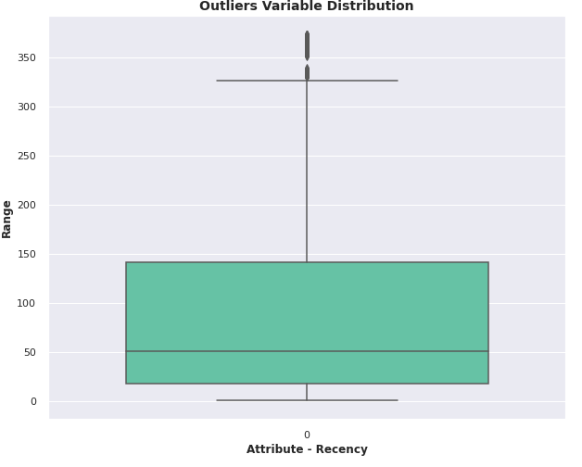
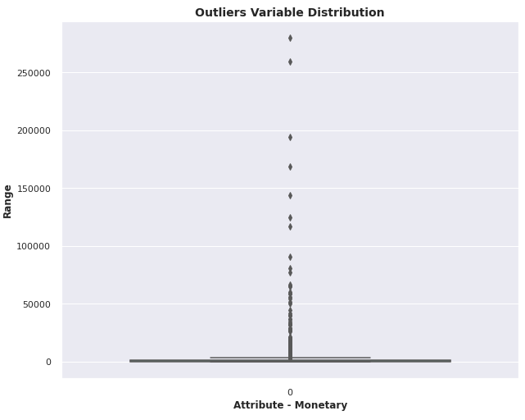
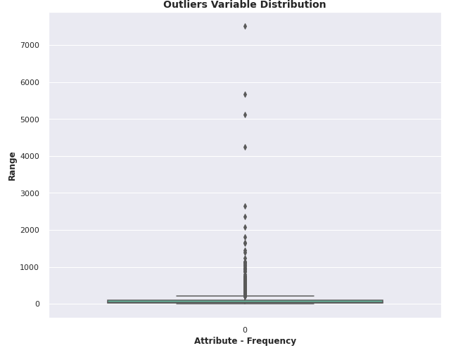
Outlier
Conclusion
So basically we need to treat the outliers which are present in the Recency, Monetary, Frequency etc.

Slide 10
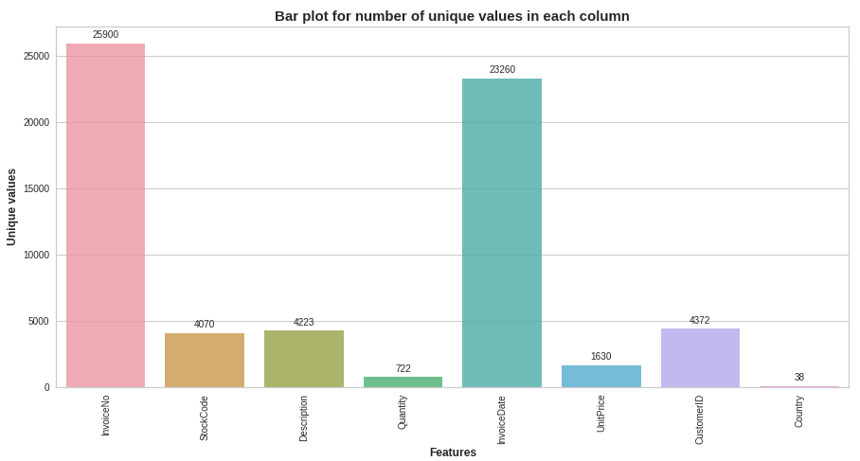
EDA
Conclusion: We can easily interpret from the above graph that most of the unique value section is Invoice number followed by Invoice date.

Slide 11
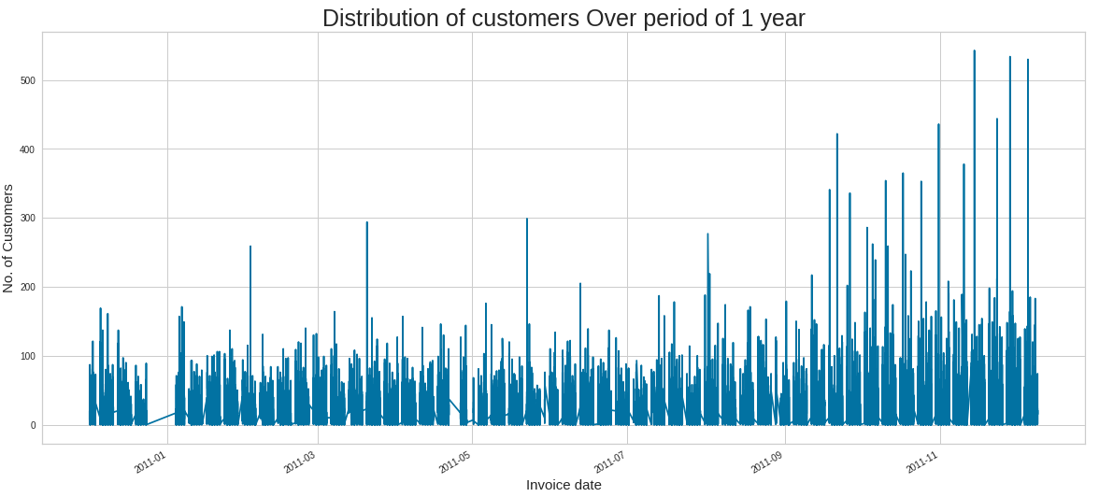
EDA (continued)
Conclusion
From the above graph we can conclude that the customer are relatively increasing from the july moth of the year.

Slide 12
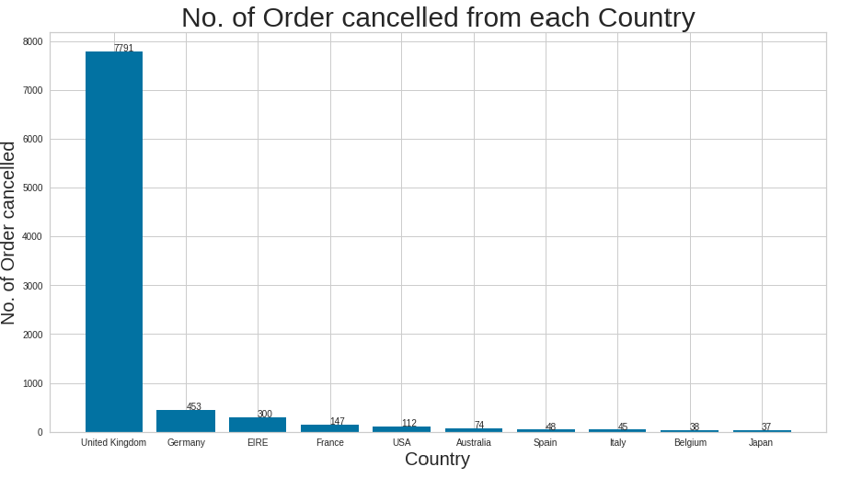
EDA (continued)
Conclusion
From the Above Bar plot we can clearly see that the maximum number of order cancellation done from United Kingdom and the Germany .

Slide 13
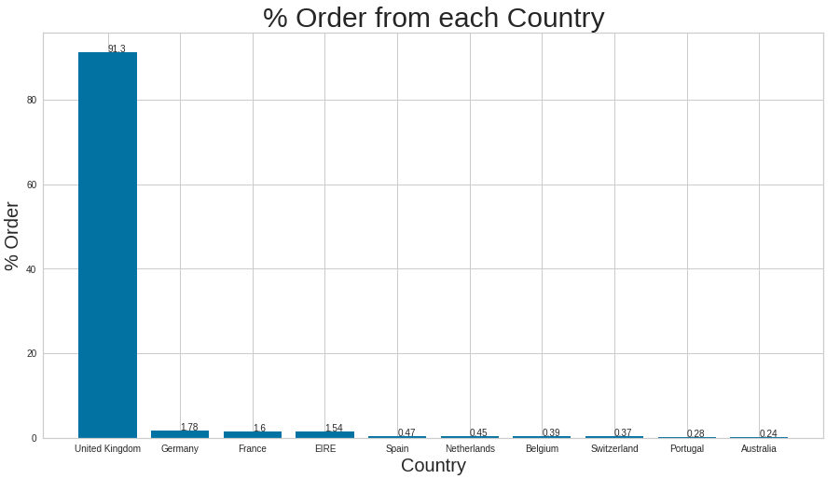
EDA (continued)
Conclusion
From the above graph we can conclude that the most order come from United kingdom with 91.3% and The Germany has only 1.78%.

Slide 14
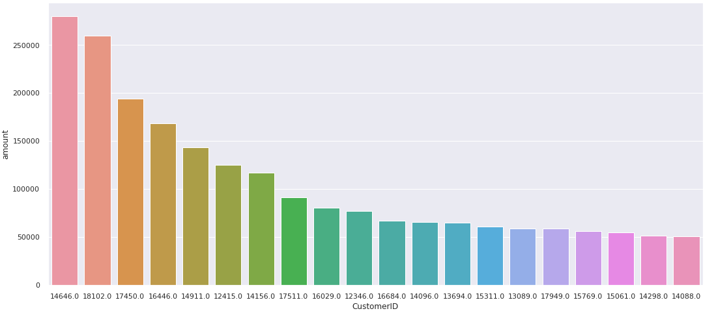
EDA
Conclusion
From the above graph we can interpret that these are the top 20 CustomerIDs that they have spent most of the amout.

Slide 15
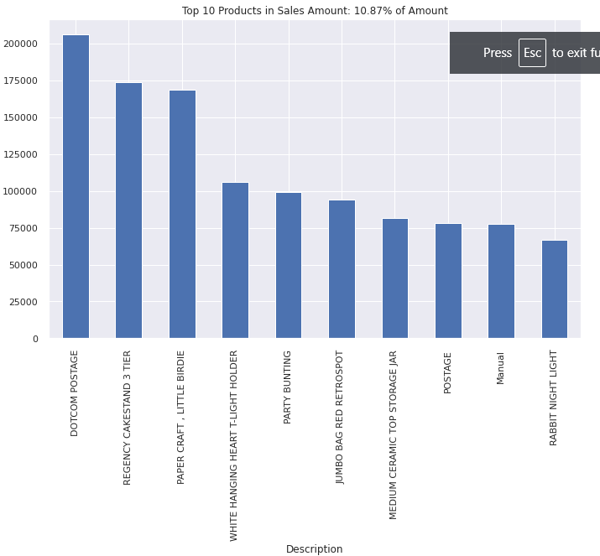
EDA (continued)
Conclusion
From the above bar graph we can easly interpret the 10 products of the total sales.
Few of them are like dotcom postage, regency cake stand 3 tier, paper craft little birdie etc.

Slide 16
FEATURE ENGINEERING
Feature engineering is the process of selecting, manipulating, and transforming raw
data into features that can be used in supervised learning.
Feature Engineering consists of various process :
Feature Creation (2) Transformation (3) Feature Extraction
Feature Extraction: Feature extraction is the process of extracting features from a
data set to identify useful information.
Feature Creation: Creating features involves creating new variables which will be
most helpful for our model.
Transformations: Feature transformation is simply a function that transforms features from one representation to another.

Slide 17
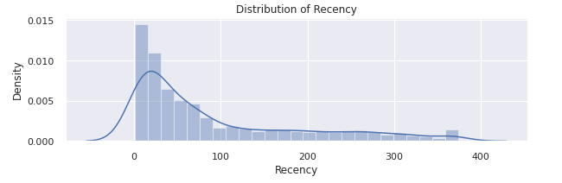
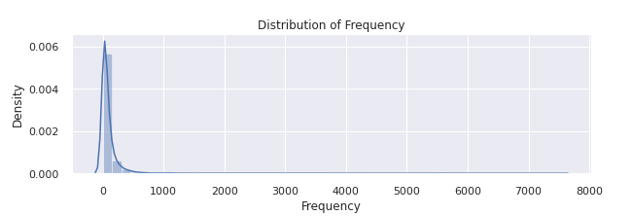
FEATURE SCALING

Slide 18
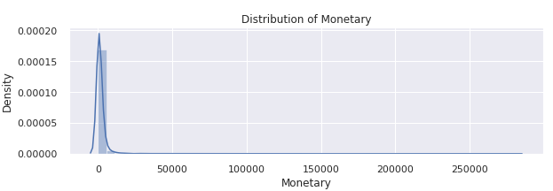
FEATURE SCALING(continued)
Conclusion
Since, all the features like Recency, Frequency and Monetary value are within varying ranges of values, we need to standardize them.
In addition, the feature like "Monetary value" can take a very large range of values.
So, to standardize all the inputs features, we apply log transform, so that the input to our clustering algorithm is a set of well scaled and transformed features.

Slide 19
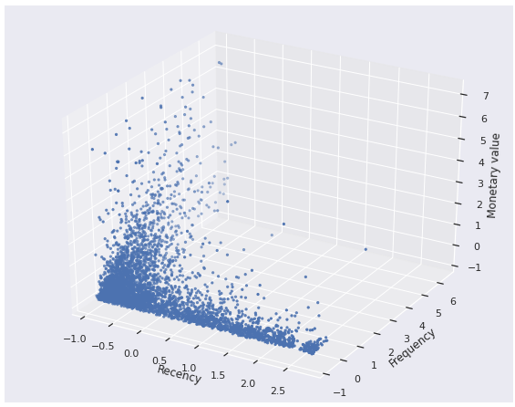
EDA (Cont…)
Visualizing the relationship between R, F and M:
Conclusion
Customers who recently bought items, are also the ones who buy more freqently and place high value orders
Customers who transacted long time ago, also place lower valued orders
Customers who buy occasionally, do not tend to buy expensive items

Slide 20
DATA MODELING
Silhouette analysis on K-Means Clustering
Silhouette analysis can be used to study the separation distance between the resulting clusters, as a strategy to quantifying the quality of clustering via graphical tool to plot a measure of how tightly grouped the samples in the clusters are. The silhouette plot displays a measure of how close each point in one cluster is to points in the neighboring clusters and thus provides a way to assess parameters like number of clusters visually.
Let's see below how our data perform for each K clusters groups (3, 5 and 7) in the silhouette score of each cluster, along with the center of each of the cluster discovered in the scatter plots, by amount recency and frequency.
Silhouette Analysis
p is the mean distance to the points in the nearest cluster that the data point is not a part of
q is the mean intra-cluster distance to all the points in its own cluster.
The value of the silhouette score range lies between -1 to 1.
A score closer to 1 indicates that the data point is very similar to other data points in the cluster,
A score closer to -1 indicates that the data point is not similar to the data points in its cluster.

Slide 21
DATA MODELING
Hierarchical Clustering
Hierarchical clustering involves creating clusters that have a predetermined ordering from top to bottom. For example, all files and folders on the hard disk are organized in a hierarchy. There are two types of hierarchical clustering,
Divisive
Agglomerative
Single Linkage:
In single linkage hierarchical clustering, the distance between two clusters is defined as the shortest distance between two points in each cluster. For example, the distance between clusters “r” and “s” to the left is equal to the length of the arrow between their two closest points.

Slide 22
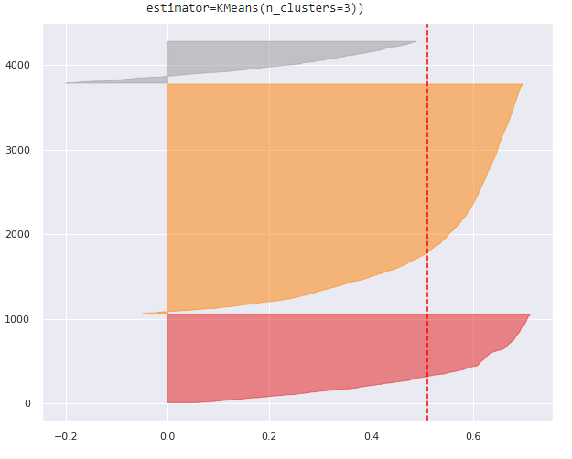
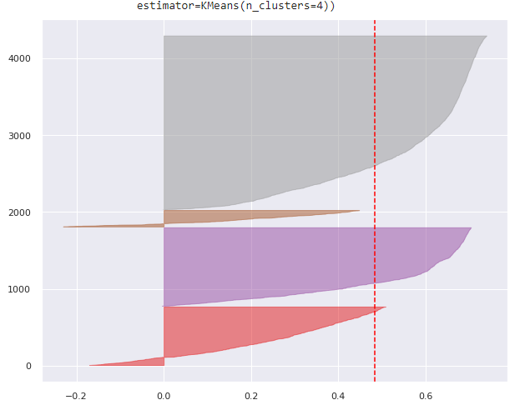
DATA MODELING (continued)

Slide 23
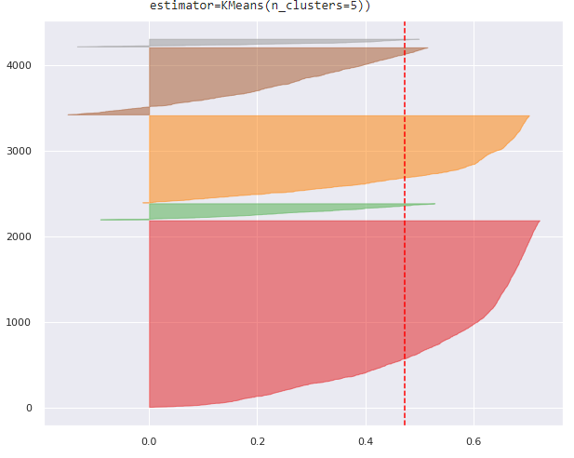
DATA MODELING (continued)

Slide 24
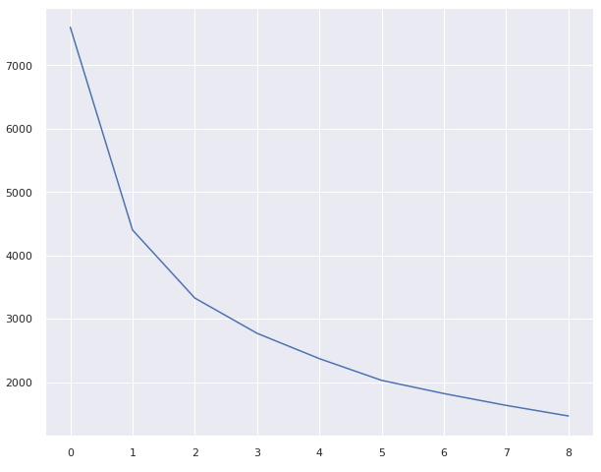
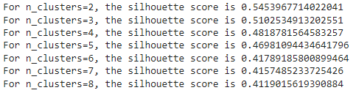
DATA MODELING (continued)
Finding best value for k(The Elbow Method)

Slide 25
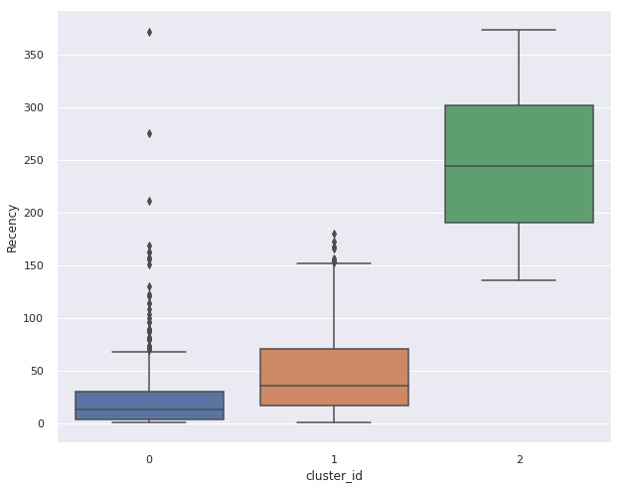
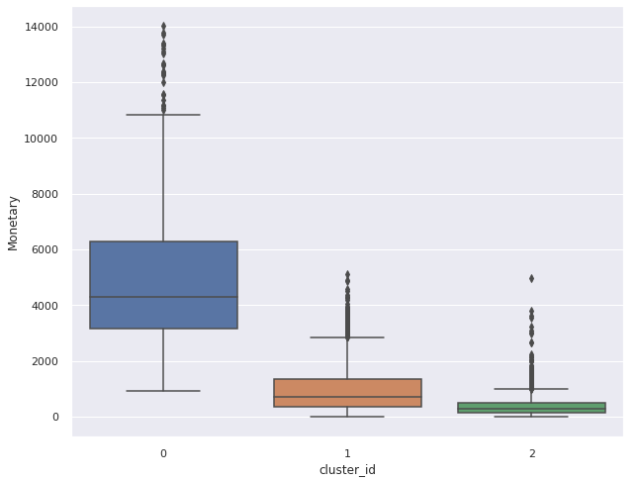
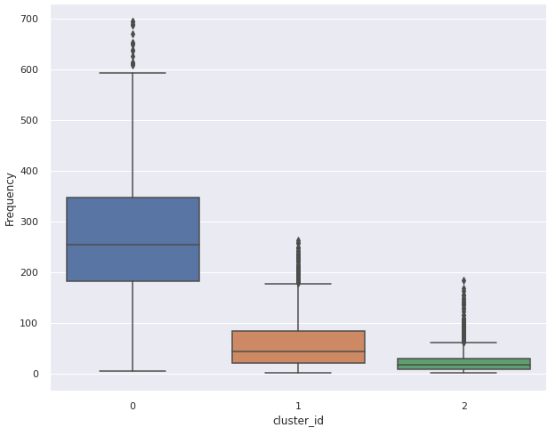
DATA MODELING (continued)

Slide 26
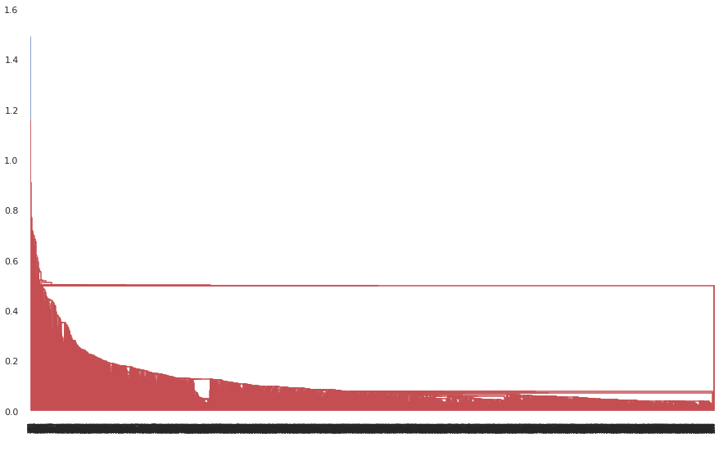
DATA MODELING (continued)
Hierarchical Clustering
Single Linkage:
In single linkage hierarchical clustering, the distance between two clusters is defined as the shortest distance between two points in each cluster. For example, the distance between clusters “r” and “s” to the left is equal to the length of the arrow between their two closest points.

Slide 27
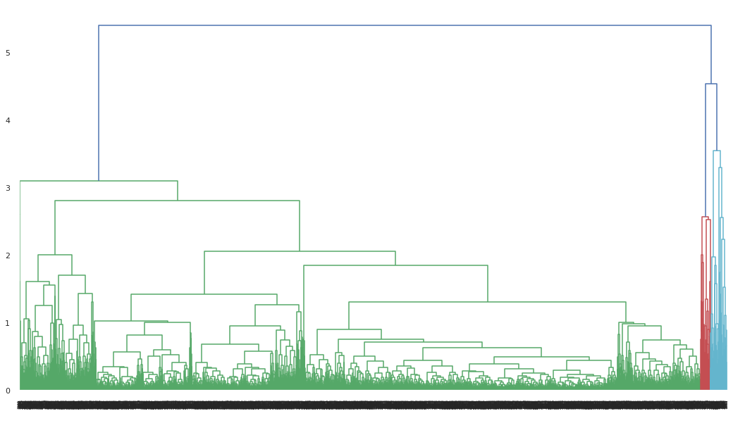
DATA MODELING (continued)
Hierarchical Clustering
In average linkage hierarchical clustering, the distance between two clusters is defined as the average distance between each point in one cluster to every point in the other cluster. For example, the distance between clusters “r” and “s” to the left is equal to the average length each arrow between connecting the points of one cluster to the other.
Average Linkage:

Slide 28
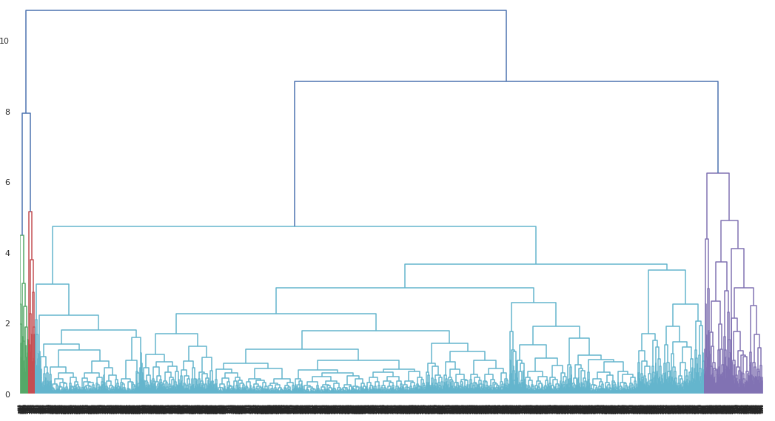
DATA MODELING (continued)
Hierarchical Clustering
Complete-linkage clustering is one of several methods of agglomerative hierarchical clustering. At the beginning of the process, each element is in a cluster of its own. The clusters are then sequentially combined into larger clusters until all elements end up being in the same cluster
Complete-linkage clustering:

Slide 29
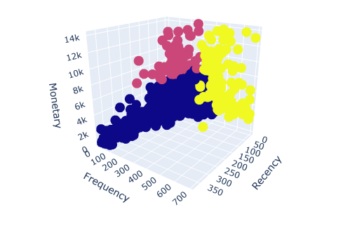
FINAL 3D VISUALIZATION

Slide 30
CONCLUSION
RFM analysis can segment customers into homogenous group quickly with set of minimum variables.
Scoring system can be defined and ranged differently. We get a better result for clustering steps by applying scoring rather than using the raw calculated RFM values.
Therefore, segmenting should be done by RFM scoring and further analysis on the spending behavior should be done on the raw values for the targeted cluster to expose more insight and characteristics.
RFM analysis solely depends on purchasing behavior and histories, analysis can be further improved by exploring weighted composite scoring or including customer demographic information and product information.
A good analysis can increase effectiveness and efficiency of marketing plans, hence increase profitability at minimum cost

Slide 31
CONCLUSION
Three Clusters (Customer Segments):
Carefully examining the three cluster classification, we observe following groups of customers:
High value customer:
'Cluster 2' is the high value customer segment for the online retails store as the customers in this group place the highest value orders with a very high relative frequency than other members. They are also the ones who have transacted the most recently.
Medium value customer:
'Cluster 0' appears to be the medium valued customer segment. These customers place an order of a considerable amount, though not as much as high valued customers, but still quite higher than low valued customers. Also, their orders are relatively more frequent than the lowest value segment.
Low value customer:
It is quite evident that 'Cluster 1' has customers who rarely shop and when they order, their orders are pretty low valued. Apart from the numbers, the visualization of clusters in Silhoutte Analysis show that all three customer segments are quite distinct with very less overlapp between them. The general trend resonated in these 3 clusters is that high monetary value is correlated with high frequency of orders and more recent ones.

Slide 32
Thank You

